Slide 1
About me
Open slide Personal/Intro.pptx

Slide 2
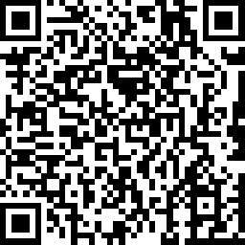
Materials

Slide 3
Quantum communication
Quantum technology
Post-quantum communication
Communication
Quantum computing

Slide 4
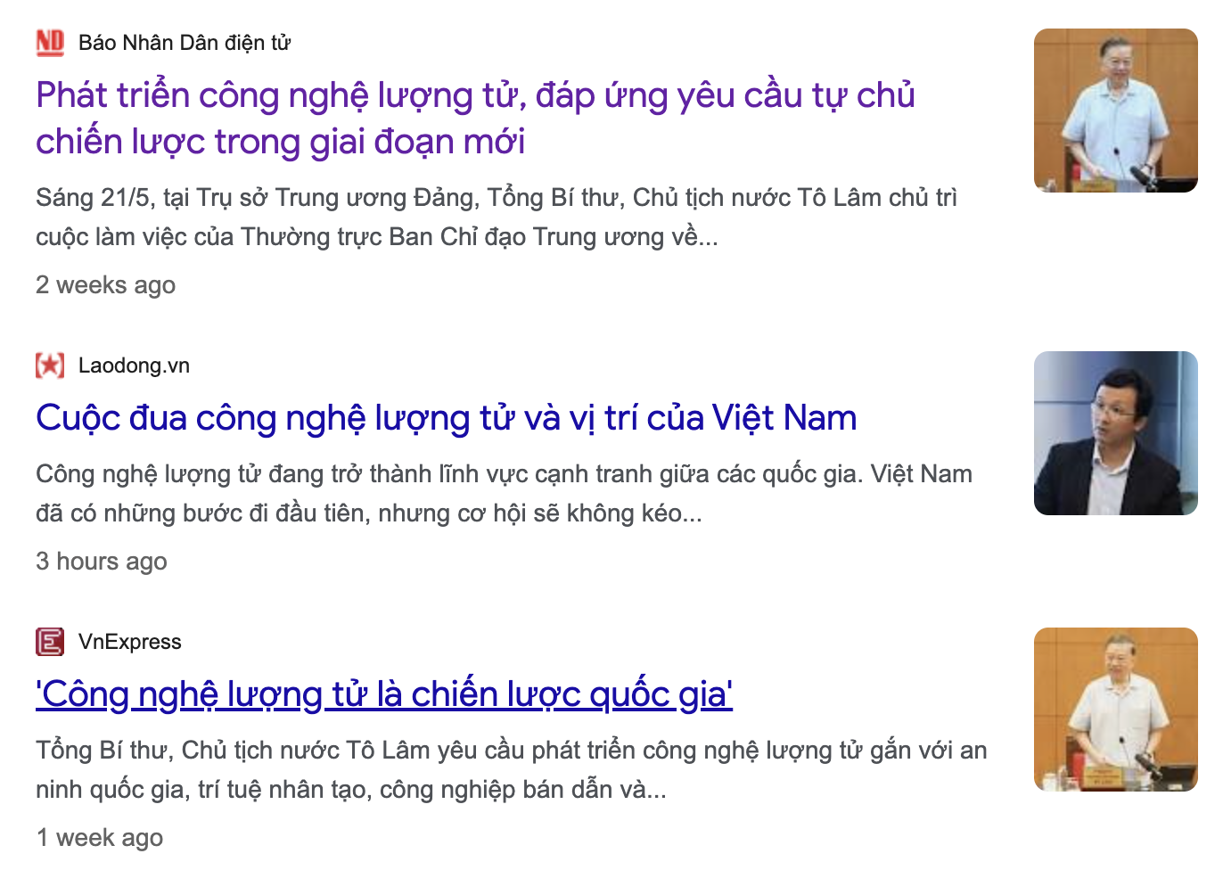
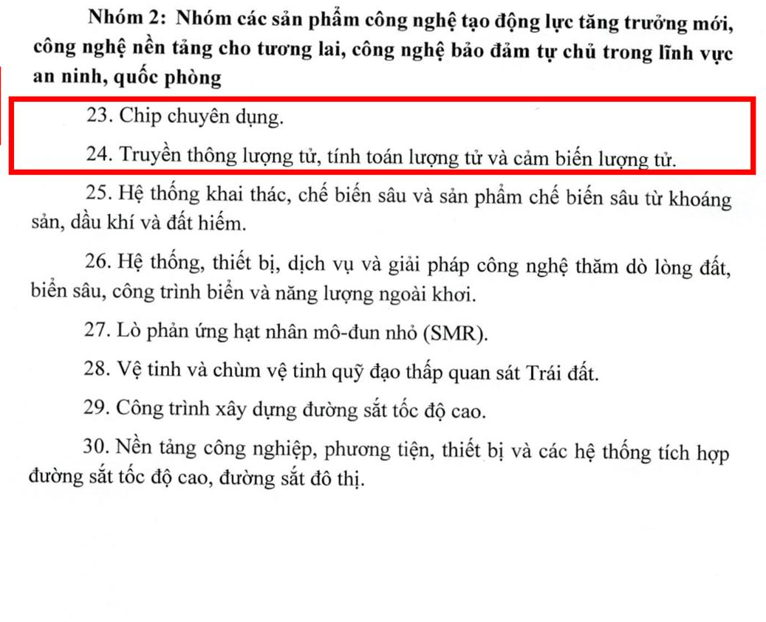
Why Quantum?
Danh mục sản phẩm công nghệ chiến lược được Chính phủ ban hành 30/4/202

Slide 5
Overview
Field | Algorithm | Problem
Quantum computing | Shor | Breaking RSA, ECC
 | Grover | Breaking AES
 | HHL | Fast linear eq system solver
Quantum communication (QKD) | BB84, B92, EPR protocol | New KEM
Post-quantum communication | CRYSTALS-Kyper | New KEM (ML-KEM / Module lattice Key-exchange mechanism)
 | CRYSTALS-Dilithium | New DSA (ML-DSA / Module lattice Digital signature algorithm)
Learn in next 2 weeks

Slide 6
Introducing to quantum computing
Open slide SExxx-Quantum Computing/0.overview.pptx

Slide 7
Why quantum do something better than classical? See quantum / classical Turing machine
Open slide SExxx-Quantum Computing/x.quantum_complexity.pptx

Slide 8
Example quantum algorithm: Quantum walk
Open slide SExxx-Quantum Computing/x.quantum_algo.pptx

